Slide 1



Syntax Analysis

Slide 2
Syntax Analysis
By design, every programming language has precise rules that prescribe the syntactic structure of well-formed programs. In C, for example, a program is made up of functions, a function out of declarations and statements, a statement out of expressions, and so on. The syntax of programming language constructs can be specified by context-free grammars or BNF (Backus-Naur Form) notation

Slide 3
Grammar
Grammars offer significant benefits for both language designers and compiler writers.
A grammar gives a precise, yet easy-to-understand, syntactic specification of a programming language.
From certain classes of grammars, we can construct automatically an efficient parser that determines the syntactic structure of a source program.
As a side benefit, the parser-construction process can reveal syntactic ambiguities and trouble spots that might have slipped through the initial design phase of a language.

Slide 4
Grammar
Grammars offer significant benefits for both language designers and compiler writers.
The structure imparted to a language by a properly designed grammar is useful for translating source programs into correct object code and for detecting errors.
A grammar allows a language to be evolved or developed iteratively, by adding new constructs to perform new tasks. These new constructs can be integrated more easily into an implementation that follows the grammatical structure of the language.

Slide 5
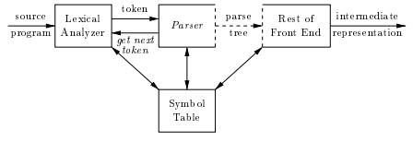
The Role of the Parser
In our compiler model, the parser obtains a string of tokens from the lexical analyzer and verifies that the string of token names can be generated by the grammar for the source language. We expect the parser to report any syntax errors in an intelligible fashion and to recover from commonly occurring errors to continue processing the remainder of the program.

Slide 6
The Role of the Parser
Conceptually, for well-formed programs, the parser constructs a parse tree and passes it to the rest of the compiler for further processing. In fact, the parse tree need not be constructed explicitly, since checking and translation actions can be interspersed with parsing, as we shall see. Thus, the parser and the rest of the front end could well be implemented by a single module.

Slide 7
Types of Parser For Grammars
There are three general types of parsers for grammars:
universal
top-down
bottom-up
Universal parsing methods such as the Cocke-Younger-Kasami algorithm and Earley's algorithm can parse any grammar. These general methods are, however, too inefficient to use in production compilers.
The methods commonly used in compilers can be classified as being either top-down or bottom-up. As implied by their names, top-down methods build parse trees from the top (root) to the bottom (leaves), while bottom-up methods start from the leaves and work their way up to the root. In either case, the input to the parser is scanned from left to right, one symbol at a time.

Slide 8
Syntax Error Handling
If a compiler had to process only correct programs, its design and implementation would be simplified greatly. However, a compiler is expected to assist the programmer in locating and tracking down errors that inevitably creep into programs, despite the programmer's best efforts. Strikingly, few languages have been designed with error handling in mind, even though errors are so commonplace.
Our civilization would be radically different if spoken languages had the same requirements for syntactic accuracy as computer languages. Most programming language specifications do not describe how a compiler should respond to errors error handling is left to the compiler designer. Planning the error handling right from the start can both simplify the structure of a compiler and improve its handling of errors.

Slide 9
Syntax Error Handling
Common programming errors can occur at many different levels.
Lexical errors include misspellings of identifiers, keywords, or operators e.g. missing quotes around text intended as a string.
Syntactic errors include misplaced semicolons or extra or missing braces that is, \{" or \}."
Semantic errors include type mismatches between operators and operands, e.g., the return of a value in a Java method with result type void.
Logical errors can be anything from incorrect reasoning on the part of the programmer to the use in a C program of the assignment operator = instead of the comparison operator ==.

Slide 10
Syntax Error Handling
The error handler in a parser has goals that are simple to state but challenging to realize:
Report the presence of errors clearly and accurately.
Recover from each error quickly enough to detect subsequent errors.
Add minimal overhead to the processing of correct programs.

Slide 11
Error-Recovery Strategies
Following are the recovery strategies:
Panic-mode Recovery
Phrase-level Recovery
Error-productions
Global-correction

Slide 12
Error-Recovery Strategies
Panic-mode Recovery
With this method, on discovering an error, the parser discards input symbols one at a time until one of a designated set of synchronizing tokens is found.
The synchronizing tokens are usually delimiters, such as semicolon or }, whose role in the source program is clear and unambiguous. The compiler designer must select the synchronizing tokens appropriate for the source language. While panic-mode correction often skips a considerable amount of input without checking it for additional errors, it has the advantage of simplicity, and, unlike some methods to be considered later, is guaranteed not to go into an infinite loop.

Slide 13
Error-Recovery Strategies
Phrase-level Recovery
On discovering an error, a parser may perform local correction on the remaining input that is, it may replace a prefix of the remaining input by some string that allows the parser to continue. A typical local correction is to replace a comma by a semicolon, delete an extraneous semicolon, or insert a missing semicolon.
The choice of the local correction is left to the compiler designer. Of course, we must be careful to choose replacements that do not lead to infinite loops, as would be the case, for example, if we always inserted something on the input ahead of the current input symbol.

Slide 14
Error-Recovery Strategies
Error-productions
By anticipating common errors that might be encountered, we can augment the grammar for the language at hand with productions that generate the erroneous constructs. A parser constructed from a grammar augmented by these error productions detects the anticipated errors when an error production is used during parsing. The parser can then generate appropriate error diagnostics about the erroneous construct that has been recognized in the input.

Slide 15
Error-Recovery Strategies
Global-correction
Ideally, we would like a compiler to make as few changes as possible in processing an incorrect input string. There are algorithms for choosing a minimal sequence of changes to obtain a globally least-cost correction. Given an incorrect input string x and grammar G, these algorithms will find a parse tree for a related string y, such that the number of insertions, deletions, and changes of tokens required to transform x into y is as small as possible. Unfortunately, these methods are in general too costly to implement in terms of time and space, so these techniques are currently only of theoretical interest.

Slide 16
Derivations
The construction of a parse tree can be made precise by taking a derivational view, in which productions are treated as rewriting rules. Beginning with the start symbol, each rewriting step replaces a nonterminal by the body of one of its productions. This derivational view corresponds to the top-down construction of a parse tree, but the precision afforded by derivations will be especially helpful when bottom-up parsing is discussed. As we shall see, bottom-up parsing is related to a class of derivations known as "rightmost" derivations, in which the rightmost nonterminal is rewritten at each step

Slide 17
Derivations
For example, consider the following grammar
E → E + E | E * E | - E | ( E ) | id
String : - ( id )
E→ - E → - ( E ) → - ( id )
We call such a sequence of replacements a derivation of (id) from E. This derivation provides a proof that the string - (id) is one particular instance of an expression.

Slide 18
Parse Trees And Derivations
A parse tree is a graphical representation of a derivation that filters out the order in which productions are applied to replace non terminals. Each interior node of a parse tree represents the application of a production. The interior node is labeled with the nonterminal A in the head of the production the children of the node are labeled, from left to right, by the symbols in the body of the production by which this A was replaced during the derivation.

Slide 19
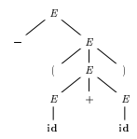
Parse Trees And Derivations
For Example, the parse tree for :
– ( id +id )
The leaves of a parse tree are labeled by non terminals or terminals and, read from left to right, constitute a sentential form, called the yield or frontier of the tree.

Slide 20
Ambiguity
A grammar that produces more than one parse tree for some
sentence is said to be ambiguous.
Put another way, an ambiguous grammar is one that produces more than one leftmost derivation or more than one rightmost derivation for the same sentence.
If the grammar has ambiguity, then it is not good for compiler construction. No method can automatically detect and remove the ambiguity, but we can remove ambiguity by re-writing the whole grammar without ambiguity.

Slide 21
Ambiguity
Let us consider a grammar G with production rule
E → I
E → E + E
E → E * E
E → ( E )
I → null | 0 | 1 |…| 9

Slide 22
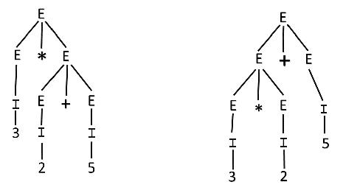
Ambiguity Solution
For the string "3 * 2 + 5", the above grammar can generate two parse trees by leftmost derivation:
Since there are two parse trees for a single string "3 * 2 + 5", the grammar G is ambiguous.

Slide 23
Difference Between Ambiguous and Unambiguous Grammar
AMBIGUOUS GRAMMAR | UNAMBIGUOUS GRAMMAR
A grammar is said to be ambiguous if for at least one string generated by it, it produces more than one- parse tree or derivation tree or syntax tree or leftmost derivation or rightmost derivation | A grammar is said to be unambiguous if for all the strings generated by it, it produces exactly one- parse tree or derivation tree or syntax tree or leftmost derivation or rightmost derivation
For ambiguous grammar, leftmost derivation and rightmost derivation represents different parse trees. | For unambiguous grammar, leftmost derivation and rightmost derivation represents the same parse tree.
Ambiguous grammar contains less number of non-terminals. | Unambiguous grammar contains more number of non-terminals.

Slide 24
Difference Between Ambiguous and Unambiguous Grammar
AMBIGUOUS GRAMMAR | UNAMBIGUOUS GRAMMAR
For ambiguous grammar, length of parse tree is less. | For unambiguous grammar, length of parse tree is large.
Ambiguous grammar is faster than unambiguous grammar in the derivation of a tree. (Reason is above 2 points) | Unambiguous grammar is slower than ambiguous grammar in the derivation of a tree.
Example- E → E + E / E x E / id | Example- E → E + T / T T → T x F / F F → id

Slide 25
Exercise whether the given grammar G is ambiguous or not
A→AA
A→(A)
A→a

Slide 26
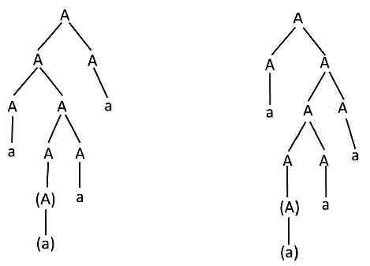
Solution
For the string "a(a)aa" the above grammar can generate two parse trees
Since there are two parse trees for a single string "a(a)aa", the grammar G is ambiguous.

Slide 27
Unambiguous Grammar
A grammar can be unambiguous if the grammar does not contain ambiguity that means if it does not contain more than one leftmost derivation or more than one rightmost derivation or more than one parse tree for the given input string.
To convert ambiguous grammar to unambiguous grammar, we will apply the following rules:

Slide 28
Ambiguous grammar to Unambiguous grammar Rules
Step 1: If the left associative operators (+, -, *, /) are used in the production rule, then apply left recursion in the production rule. Left recursion means that the leftmost symbol on the right side is the same as the non-terminal on the left side.
For example:
X → Xa

Slide 29
Ambiguous grammar to Unambiguous grammar Rules
Step 2: If the right associative operates(^) is used in the production rule then apply right recursion in the production rule. Right recursion means that the rightmost symbol on the left side is the same as the non-terminal on the right side.
For example:
X → aX

Slide 30
Example
Consider a grammar G is given as follows:
S → AB | aaB
A → a | Aa
B → b
Determine whether the grammar G is ambiguous or not. If G is ambiguous, construct an unambiguous grammar equivalent to G.

Slide 31
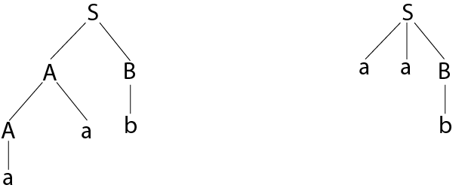
Example Continues
As there are two different parse tree for deriving the same string, the given grammar is ambiguous.

Slide 32
Example Continues
Unambiguous grammar will be:
S → AB
A → Aa | a
B → b

Slide 33
Example 2
Show that the given grammar is ambiguous. Also, find an equivalent unambiguous grammar.
S → ABA
A → aA | ε
B → bB | ε

Slide 34
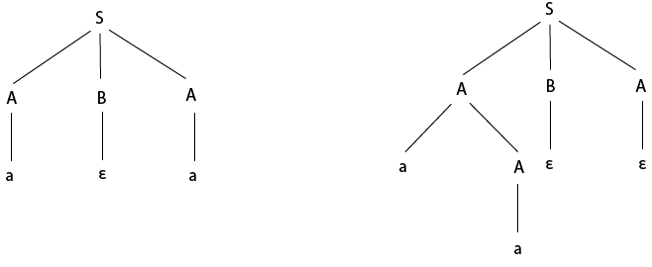
Example 2
The given grammar is ambiguous because we can derive two different parse tree for string aa.

Slide 35
Example 2
The unambiguous grammar is:
S → aXY |bYZ |ε
Z → aZ | a
X → aXY | a | ε
Y → bYZ | b | ε

Slide 36
Example 3
Show that the given grammar is ambiguous. Also, find an equivalent unambiguous grammar.
E → E + E
E → E * E
E → id

Slide 37
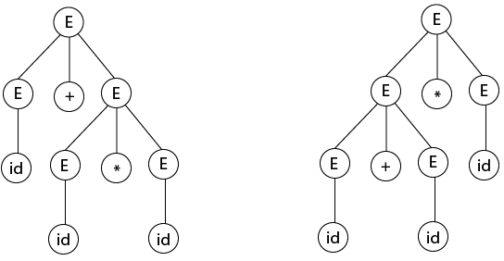
Example 3
Solution:
Let us derive the string "id + id * id"

Slide 38
Example 3
As there are two different parse tree for deriving the same string, the given grammar is ambiguous.
Unambiguous grammar will be:
E → E + T
E → T
T → T * F
T → F
F → id

Slide 39
Inherently ambiguous Language:
Let L be a Context Free Language (CFL). If every Context Free Grammar G with Language L = L(G) is ambiguous, then L is said to be inherently ambiguous Language. Ambiguity is a property of grammar not languages. Ambiguous grammar is unlikely to be useful for a programming language, because two parse trees structures(or more) for the same string(program) implies two different meanings (executable programs) for the program.
An inherently ambiguous language would be absolutely unsuitable as a programming language, because we would not have any way of fixing a unique structure for all its programs.

Slide 40
Inherently ambiguous Language:
For example,
L = {a^nb^nc^m} ∪ {a^nb^mc^m}
Note : Ambiguity of a grammar is undecidable, i.e. there is no particular algorithm for removing the ambiguity of a grammar, but we can remove ambiguity by:
Disambiguate the grammar i.e., rewriting the grammar such that there is only one derivation or parse tree possible for a string of the language which the grammar represents.

Slide 41
Thank You

